Slide 1
The 2nd Joint Kyoto-NTU High Energy Theory Workshop
Welcome!

Slide 2
Non-Abelian Gauge Symmetries Beyond Yang-Mills
Pei-Ming Ho
Physics Department
National Taiwan University
March, 2015

Slide 3
Yang-Mills Gauge Symm.
Gauge symm. in YM (and CS):
gauge group = (finite-dim.) Lie group
0-form gauge parameter λ
1-form gauge potential A
2-form field strength F = dA + AA

Slide 4
Generalization #1
n-form gauge parameter λ
with (n-1)-form redundancy λ~λ+ dε
(n+1)-form gauge potential A
(n+2)-form field strength F = dA + ?
Question: How to be non-Abelian?

Slide 5
M5-brane effective theory
1-form gauge parameters
with 0-form redundancy
2-form gauge potential
3-form field strength
N = (0, 2) supersymmetry
Self-duality
1 M5 [Perry-Schwarz 96][Pasti-Sorokin-Tonin 96]
→ 1 M5 in C-field, Multiple M5 on S¹
Abelian
non-Abelian

Slide 6
Single M5 in C-field
[Ho-Matsuo 08][Ho-Imamura-Matsuo-Shiba 08]
[Chen-Furuuchi-Ho-Takimi 10]
Non-Abelian gauge symm.
Nambu-Poisson algebra (ex. of Lie 3-algebra in BLG)
3D Volume-Preserving Diffeom. (VPD)
DDR #1 → D4-brane in NS-NS B-field backgr’d.
Poisson limit of NC D4-brane.
DDR #2 → D4-brane in RR C-field background.
1 gauge potential for 2 gauge symmetries. [Ho-Yeh 11]
T-duality: Dp-brane in RR (p-1)-form backgr’d.
[Ho-Yeh 14, Ho-Ma 14]

Slide 7
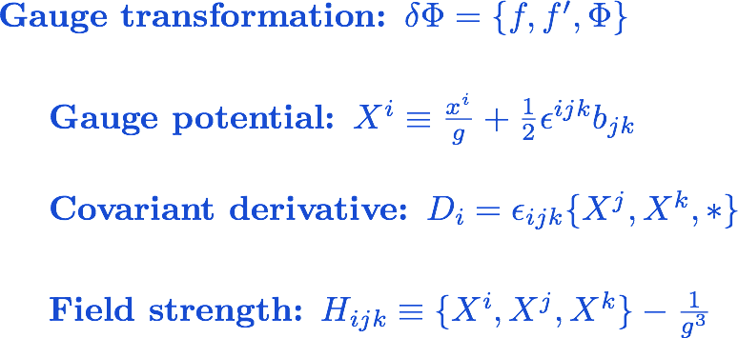
Nambu-Poisson

Slide 8
Multiple M5-branes
Low energy effective theory of N M5 on S¹
finite R → infinite KK modes
non-Abelian B(2) → B(2)+A(1)
self-duality H(3) = *H(3).
The gauge field sector is already challenging.
Non-locality to evade no-go theorem
[Bekaert-Henneaux-Sevrin 99,99,00]
Single M5 limit and N D4 limit are known.
[Ho-Huang-Matsuo 11][Ho-Matsuo 12, 14]
Partial SUSY (1, 0)
[Bonetti-Grimm-Hohenegger 12], [Ho-Matsuo 14]

Slide 9
Gauge symmetry
[Ho-Huang-Matsuo 11]
Decompose all fields into 0/KK- modes
gauge transformation parameter
gauge transformations
identify a 1-form potential (nonlocally)

Slide 10
Gauge symmetry algebra
[Ho-Huang-Matsuo 11]
where
Gauge symmetry of gauge symmetry

Slide 11
Field strength
[Ho-Huang-Matsuo 11]
Field strengths are covariant.
There is no need to define due to self duality.

Slide 12
Geometry of higher form gauge fields
1-form gauge potential = bundle
transition function
consistency condition for transition functions
2-form gauge potential = gerbe
violation of consistency condition
consistency condition for violation of the above c.c.
where

Slide 13
Non-Abelian gerbe
Math. refs. [Breen-Messing 01][Baez-Huerta 10]
Two Lie algebras
Need a few maps with some conditions.
Problem:
Fake curvature condition
It is hard to have non-trivial field strength.

Slide 14
Non-Abelian Gerbe (modified)
Given two Lie algebras and 3 linear maps [Ho-Matsuo 12]
They satisfy the following properties.

Slide 15
Non-Abelian Higher Form Symmetries
[Gaiotto-Kapustin-Seiberg-Willett 14]
All higher form symmetries are Abelian (?)
Non-trivial space-time dependence:
derivatives, non-locality, …

Slide 16
Generalization #2
Normally,
gauge transf. = (finite-dim.) Lie group-valued fxs
potential = Lie alg. ⊗ 1-form
Now,
→ Mix Lie alg. and alg. of fxs on space-time.
All formulas still work.
D = d + A
δA = [D,λ]
F = dA + AA

Slide 17
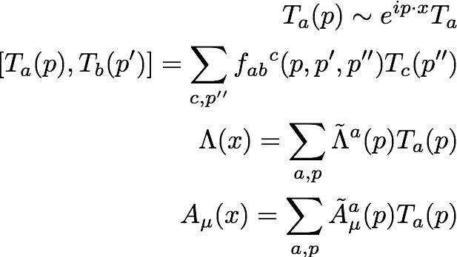
Gauge symm. algebra
structure const’s depend on kinem. param’s.
ex: NC gauge symm.
More generally,
gauge alg. ≠ product alg.
T_{a} x exp(ipx) → T_{a} (p) → T(…)
Notes:
We need a motivation.

Slide 18
BCJ Duality and Double Copy Procedure (generalized KLT relation)
(color)*(kin.) → (kin.)’*(kin.)
Gravity = (YM)*(YM)’
(color) → (kin.)’ ?
structure const. = kinematic factor?
Gravity = (YM)”
[A,A]∂A →
⇒ want f ~ F ?

Slide 19
(Not Jacobi!)
Everything is on-shell.

Slide 20
Example of generalization #2
Assumptions:
Poincare symmetry (Minkowski space)
Lorentz index as internal space index
Linear in wave vector
Jacobi identity
→ Diffeom. in Fourier basis
Question:
Gauge theory of diffeom. in Minkowski? [Ho 15]

Slide 21
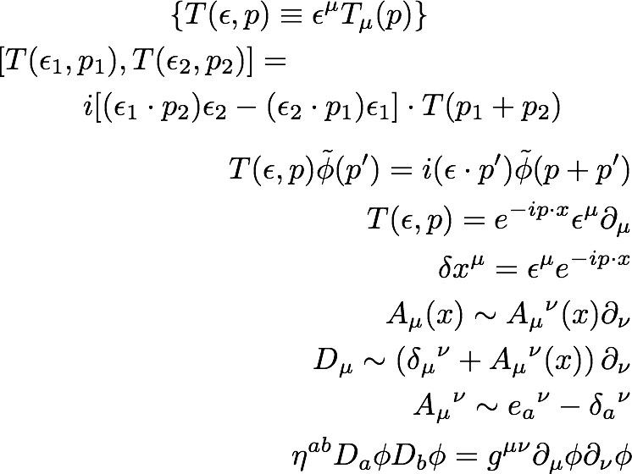
Gauge algebra of Diff.
Note that
the Lorentz index on A
turns into a frame-index a.
The internal space index on A
is identified with
the space-time index μ.

Slide 22
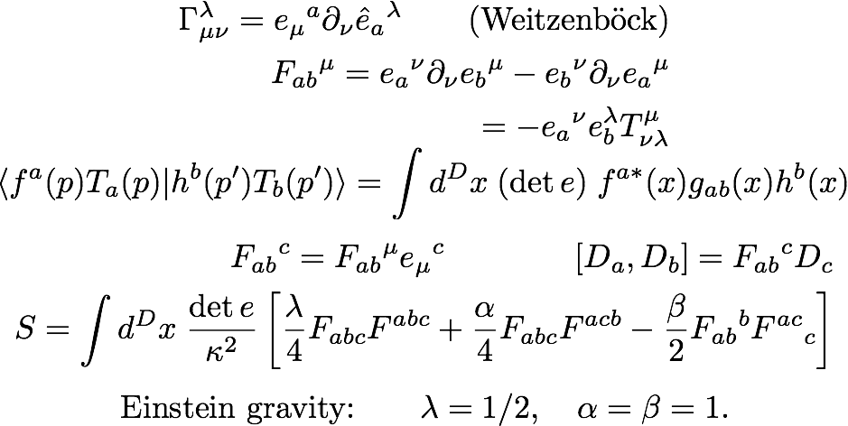
Gauge theory of Diff.
Curvature-free
Field-dep’t Killing form
→ symmetry of Lorentz rotations of frame

Slide 23
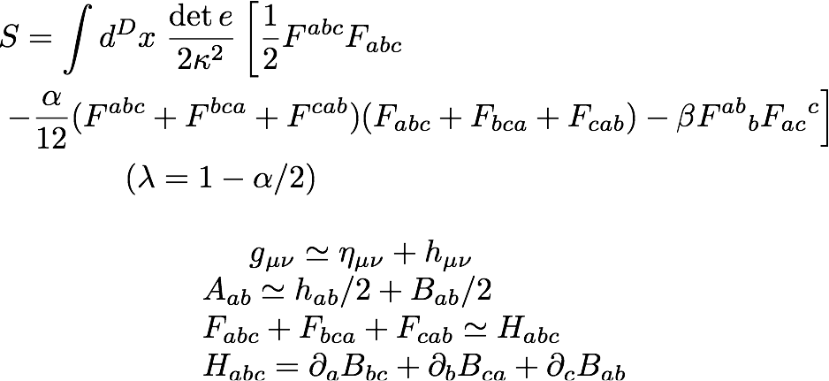
Gravity with B and φ

Slide 24
Comments
Diff. symm. in Minkowski?
Minkowski background in GR
→ spontaneous symmetry breaking
Yang-Mills theory for Diff. symmetry
on Minkowski space
without symmetry breaking
In general,
Lorentz frame rotation is not a symmetry.
Theories w. (g, B,φ) can be written as YM.

Slide 25
YM theory of Diff. on Minkowski
gauge potential =
inverse vielbein – backgr’d frame const.
field-dependent Killing form
Comparison:
Different from
3d Gravity as CS,
MacDowell-Mansouri,
Teleparallel gravity,…

Slide 26
Outlook
More (generalized) symmetries?
(borderline btw GR/YM blurred)
Pheno. Applications? (e.g. VPD?)
YM-theoretical ideas → GR?
Field-theoretic proof of double-copy procedure GR = (YM)*(YM)’ ?

Slide 27
Thank You!
END

Slide 28
Problem?
People quote
“Chiral bosons have no Lagrangian formulation.”
Why?
What about Perry-Schwarz, or Pasti-Sorokin-Tonin, etc.?
Low energy effective theory may not be good for
global questions in quantum theory,
but is still good for classical configurations (e.g. solitons)
in classical backgrounds.
Focus on the (classical) low energy effective theory now,
and consider local questions in quantum theory later.
Notes:
Witten 96: effective five-brane theory in M theory.

Slide 29
Problem?
Action for 6 dimensional theory is roughly
upon dimension reduction. The field strength
is naturally reinterpreted as a 2-form field strength in 5D
D4-action is roughly
but

Slide 30
Self-Dual Gauge Fields
When D = 2(n+1), the self-duality condition is
(a.k.a. chiral boson)
How to produce 1st order diff. eq. from action?
Trick: introduce additional gauge symmetry

Slide 31
Lagrangian for chiral bosons
“Self dual gauge field” = “chiral boson”
Literature:
Siegel (84)
Floreanini, Jackiw (87)
Henneaux, Teitelboim (88)
Witten (95)
Perry, Schwarz (96)
Pasti, Sorokin, Tonin (96)
Belov, Moore (06)
Chen-Ho (10)

Slide 32
Action
The 6D action for chiral boson
After compactification
Denoting
the equation of motion for the KK mode is
which is equivalent to

Slide 33
Comments
KK modes appear as matter fields in 5D.
All interactions mediated by the 1-form potential A
[Czech-Huang-Rozali ’11]
Instanton number is not the only contribution
to the 5th momentum
P₅ = Q_{(instanton)} + Q_{(KK)}

Slide 34
Example
Lie group K with a representation V
Then we define
Stueckelberg mechanism: B eats up A_{v}, leaving A_{k}.

Slide 35
Why S¹ ?
Mathematical formulation of gerbes
always includes a 1-form potential A.
To have a Lagrangian formulation
[Czech-Huang-Rozali (11)]
no nontrivial interaction before compactification
Literature:
[Lambert-Papageorgakis 10]
[Douglas 11], [Lambert-Papageorgakis-Schmidt-Sommerfeld 11]
[Ho-Huang-Matsuo 11]
[Samtleben-Sezgin-Wimmer 11], [Chu 11]
[Lambert-Richmond 11], [Kim-Kim-Koh-Lee-Lee 11], [Linander-Ohlsson 12], [Fiorenza-Sati-Schreiber 12],
[Chu-Ko 12], [Palmer-Saemann 12], [Saemann-Wolf 12], …

